Slide 1
Greater Cambridge Shared Planning
Luke Mills & Sophie Pain
(Principal Planners, Strategic Sites)

Slide 2
Northstowe Community Forum
5 March 2025
Luke Mills & Sophie Pain (Principal Planners, Strategic Sites)

Slide 4
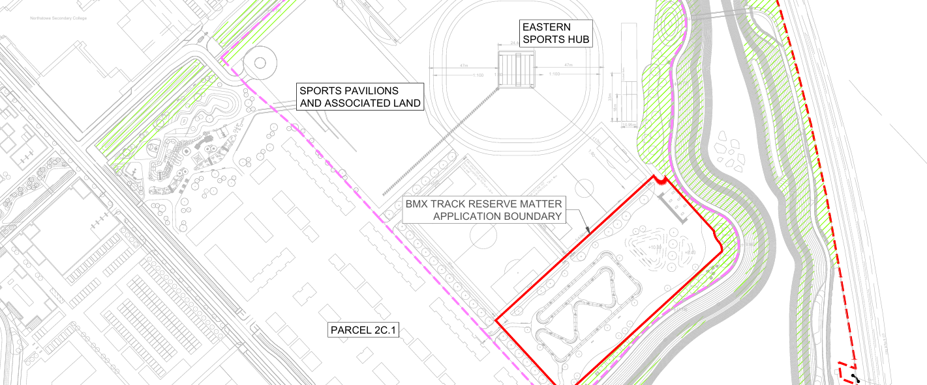
Eastern Sports Hub BMX Track

Slide 5
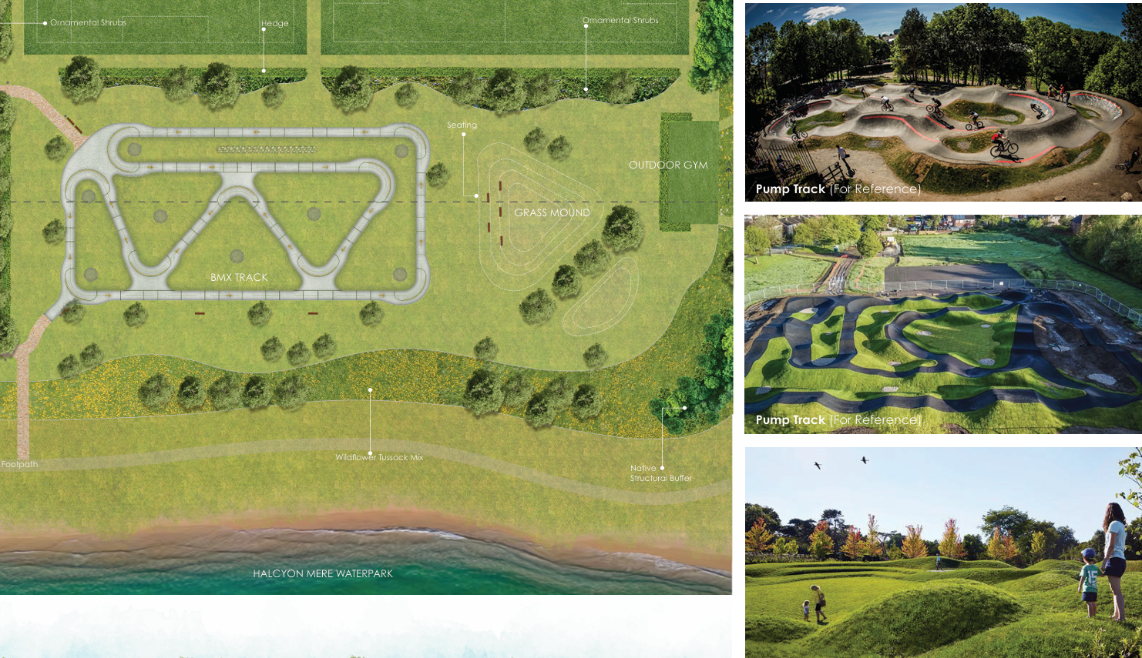
Eastern Sports Hub BMX Track

Slide 6
Contacts
Website:
www.greatercambridgeplanning.org
Planning Applications:
www.greatercambridgeplanning.org/planning-applications/view-and-comment-on-planning-applications
Planning (Northstowe)
Luke Mills
Luke.mills@greatercambridgeplanning.org
Sophie Pain
Sophie.pain@greatercambridgeplanning.org

